Slide 1
What are the benefits of investing in health and social care? How can this assist in the parliamentary scrutiny of policy?
Professor Karl Claxton
Centre for Health Economics, University of York
Much of the research findings used in this analysis was conducted as part of The Policy Research Unit in Economic Methods of Evaluation of Health and Social Care Interventions (EEPRU) which is a programme of work funded by NIHR that started in January 2019 and is a collaboration between the Universities of York and Sheffield. EEPRU aims to assist policy makers in DHSC and arm’s length bodies to improve the allocation of resources in health and social care through high quality research.
The analysis of this body of research evidence and the conclusions drawn in this presentation do not necessarily reflect the views of the University of York, the funders of this research or DHSC, NHSE and other arms length bodies.

Slide 2
A recent policy
UK-US deal on higher prices for new NHS drugs
The claimed benefits
Access to new medicines
Avoid threats of US tariffs on UK drugs
Encourage innovation and pay our ‘fair’ share
Inward investment to the UK and economic growth
Support the life sciences sector
But what will it cost the NHS each year?
£1bn Wes Streeting
£3bn Department of Health and Social Care
£6bn Lord Vallance (from 9% to 12% of total health spend)
And what will it cost after 2028 when this is renegotiated?

Slide 3
What are the real costs of £1bn?
Impact each year of £1bn in higher drug prices | Low | High
Additional deaths | 6,192 | 6,511
Years of life in good health (QALYs) | 137,894 | 145,005
Users care related quality of life | 2,631 | 4,873
Unpaid carers quality of life | 5,349 | 11,449
Total health and quality of life effect (QALYs) | 145,874 | 161,326
Total value (HMT) of health and care effects (£m) | £10,211 | £11,293
Total impact on economic growth (£m) | £6,707 | £8,825
Total value of the real costs of £1bn | £16,918 | £20,117
Scotland 9%-12%, Wales 5%-6%, Northern Ireland 3%-4%

Slide 4
So who pays these real costs?
All NHS patients
Increased mortality and reduced survival
Cancer, circulatory, respiratory and gastro-intestinal diseases
Reduced quality of life
respiratory, gastro-intestinal, endocrine, neurological, muscular skeletal and mental health problems
Increased health inequality
Increased costs for local authorities (£118m)
Users of social care and their unpaid carers
Reduction in local economic growth

Slide 5
Where do these estimates come from?

Slide 6
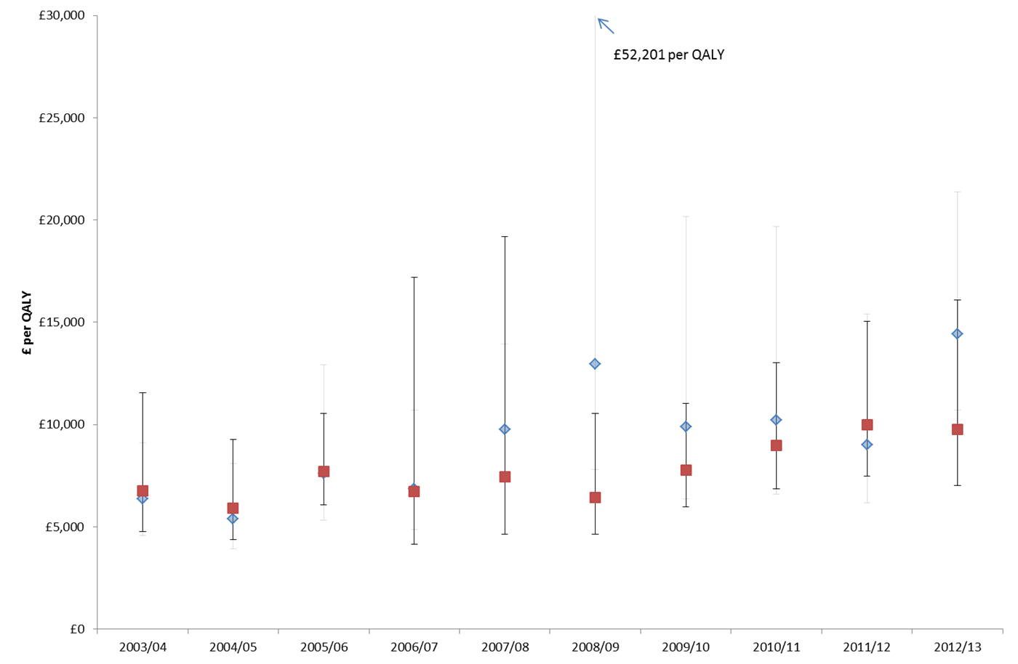
NICE stated ‘threshold’ range

Slide 7
What has happened since austerity in 2010?
It cost the NHS less to deliver one year of life in good health (QALY)
Increasing needs and more effective medicine has outpaced NHS funding
NHS is increasingly underfunded using Treasury valuations
Costs imposed on the NHS reduce health and increase health inequality
Current NICE ‘thresholds’ mean we are already doing more harm than good

Slide 8
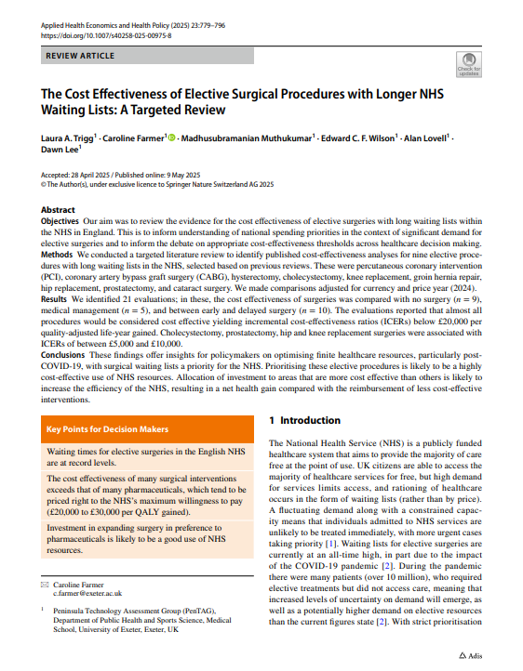
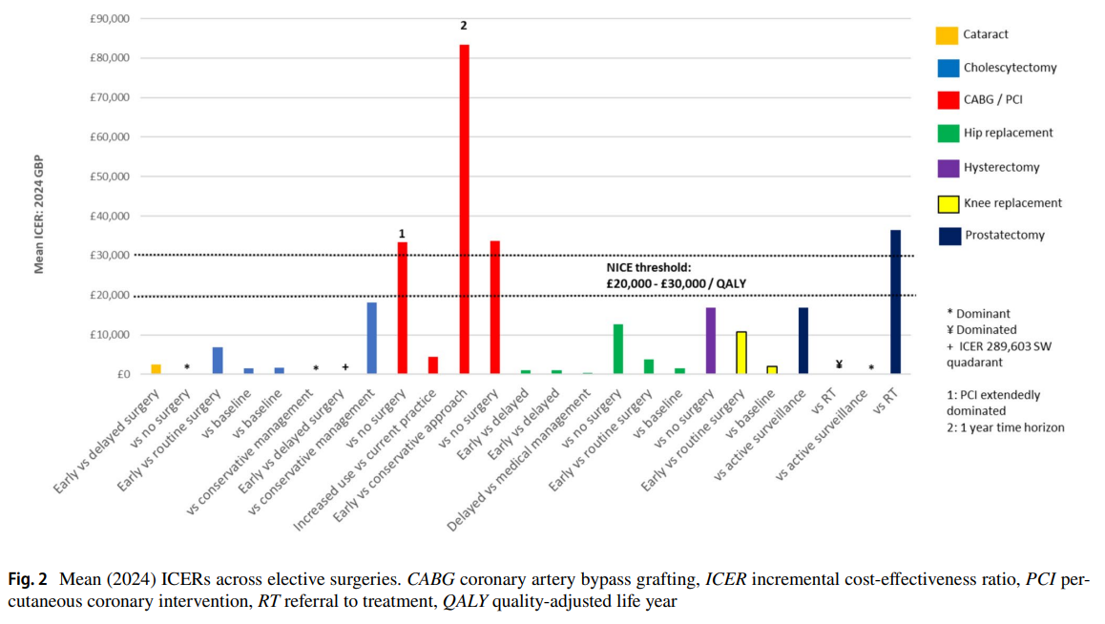
Is this surprising?

Slide 9
Publically funded Adult Social Care?
ASC expenditure makes the NHS more efficient
Improves the quality of life of users and unpaid carers
Reduces anxiety and depression (users and carers)
Increases local economic growth
NHS paying more for new drugs will increase the need for social care
Increase Local Authority costs (£118m)
Worse quality of life outcomes for users
Worse quality of life outcomes for users
Increase in anxiety and depression (users and carers)
Reduction in economic growth

Slide 10
Public health grant to Local Authorities?
Increases in Public Health expenditure is very cost-effective
Even more cost-effective than NHS expenditure
Is also likely to improve economic growth

Slide 11
So how should we invest £1bn?
 | NHS (0.55%) |  | Adult Social Care (3.4%) |  | Public health (27.32%)
Benefits each year of £1bn | Low | High | Low | High | Low | High
Reduced mortality (deaths averted) | 6,192 | 6,511 | 9,110 | 11,820 | 12,052 | 21,426
Quality Adjusted Life Years (QALYs) gained | 145,874 | 161,326 | 270,617 | 401,781 | 268,411 | 477,175
Total value of health and care effects (£bn) | £10.2 | £11.3 | £18.9 | £28.1 | £18.8 | £33.4
Increase in economic growth (£bn) | £6.7 | £8.8 | £7.6 | £10.0 | £1.6 | £3.0
Total value of the benefits of investing £1bn | £16.9 | £20.1 | £26.5 | £38.1 | £20.4 | £36.4
The value of one public pound | £17 | £20 | £27 | £38 | £20 | £36

Slide 12
So how should we invest £1bn?
 | NHS (0.55%) |  | Adult Social Care (3.4%) |  | Public health (27.32%)
Benefits each year of £1bn | Low | High | Low | High | Low | High
Reduced mortality (deaths averted) | 6,192 | 6,511 | 9,110 | 11,820 | 12,052 | 21,426
Quality Adjusted Life Years (QALYs) gained | 145,874 | 161,326 | 270,617 | 401,781 | 268,411 | 477,175
Total value of health and care effects (£bn) | £10.2 | £11.3 | £18.9 | £28.1 | £18.8 | £33.4
Increase in economic growth (£bn) | £6.7 | £8.8 | £7.6 | £10.0 | £1.6 | £3.0
Total value of the benefits of investing £1bn | £16.9 | £20.1 | £26.5 | £38.1 | £20.4 | £36.4
The value of one public pound | £17 | £20 | £27 | £38 | £20 | £36

Slide 13
So how should we invest £1bn?
 | NHS (0.55%) |  | Adult Social Care (3.4%) |  | Public health (27.32%)
Benefits each year of £1bn | Low | High | Low | High | Low | High
Reduced mortality (deaths averted) | 6,192 | 6,511 | 9,110 | 11,820 | 12,052 | 21,426
Quality Adjusted Life Years (QALYs) gained | 145,874 | 161,326 | 270,617 | 401,781 | 268,411 | 477,175
Total value of health and care effects (£bn) | £10.2 | £11.3 | £18.9 | £28.1 | £18.8 | £33.4
Increase in economic growth (£bn) | £6.7 | £8.8 | £7.6 | £10.0 | £1.6 | £3.0
Total value of the benefits of investing £1bn | £16.9 | £20.1 | £26.5 | £38.1 | £20.4 | £36.4
The value of one public pound | £17 | £20 | £27 | £38 | £20 | £36

Slide 14
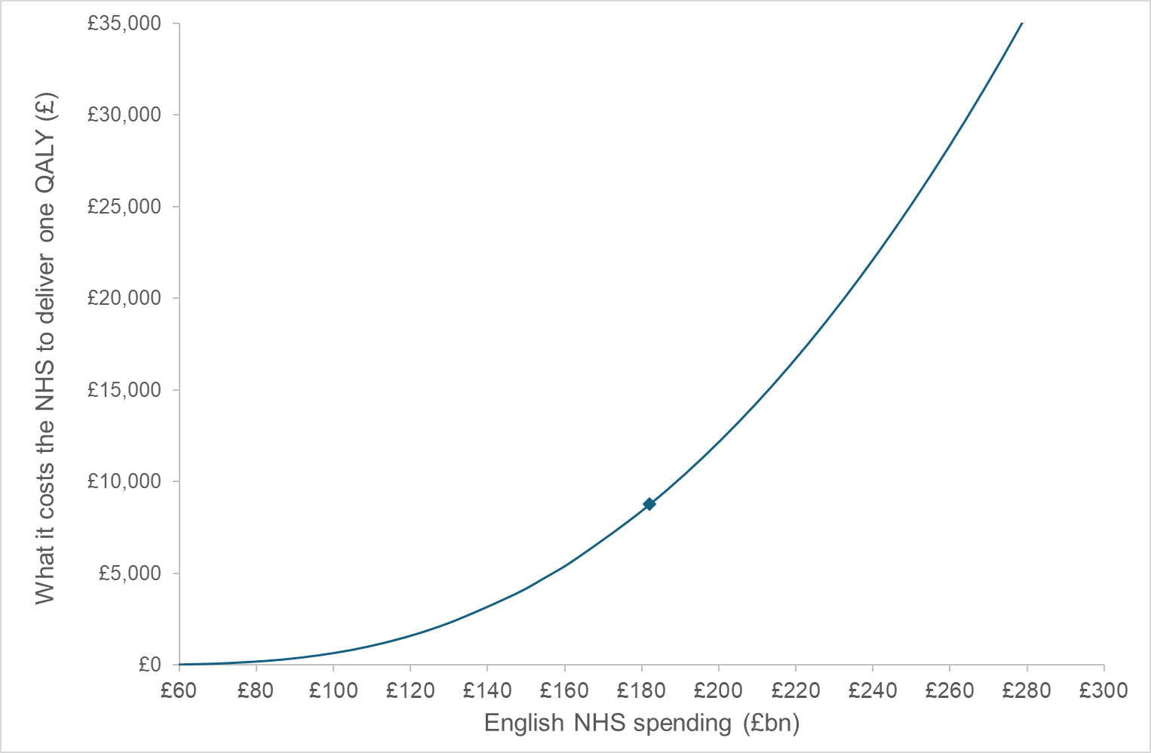
Should we increase NHS funding?
To make this ‘deal’ affordable (no worse) NHS funding would need to increase by £31.5bn

Slide 15
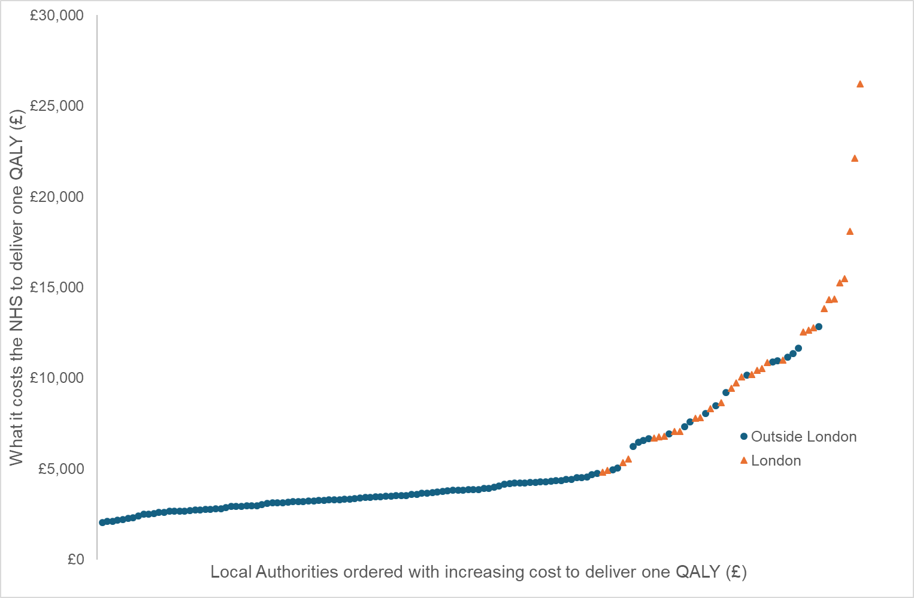
Can we improve NHS efficiency?
Periodic claims of efficiency saving are made
Few are evidence based
Often they reduce efficiency and increase NHS costs
Allocation based on evidence of benefit would
Improve health outcomes by 327,266 Quality Adjusted Life Years
Equivalent to a £2.2bn increase in NHS expenditure
Reduce health inequalities
Fully implementing the current allocation formula (2016/17)
Reduce health outcomes by 99,796 Quality Adjusted Life Years
Increase health inequalities

Slide 16
What are the likely costs of this ‘deal’
Increase the NICE threshold (£30,000 to £35,000 per QALY)
Reduce the rebate payment (24% to 15%) 14.5% announced today
 |  |  | Additional deaths
Year | Cost each year | Total cost | Total (Low) | % of Covid deaths
2026 | £464 | £464 | 2,873 | 2%
2027 | £928 | £1,392 | 8,619 | 6%
2028 | £1,392 | £2,784 | 17,237 | 13%
2029 | £1,856 | £4,640 | 28,728 | 21%
2030 | £2,320 | £6,960 | 43,093 | 31%
2031 | £2,784 | £9,744 | 60,330 | 44%
2032 | £3,248 | £12,991 | 80,440 | 59%
2033 | £3,712 | £16,703 | 103,422 | 75%
2034 | £4,176 | £20,879 | 129,278 | 94%
2035 | £4,640 | £25,519 | 158,006 | 115%
And what will it cost after 2028 when this is re-negotiated?

Slide 17
What are the likely costs of this ‘deal’
Increase the NICE threshold (£30,000 to £35,000 per QALY)
Reduce the rebate payment (24% to 15%) 14.5% announced today
 |  |  | Additional deaths
Year | Cost each year | Total cost | Total (Low) | % of Covid deaths
2026 | £464 | £464 | 2,873 | 2%
2027 | £928 | £1,392 | 8,619 | 6%
2028 | £1,392 | £2,784 | 17,237 | 13%
2029 | £1,856 | £4,640 | 28,728 | 21%
2030 | £2,320 | £6,960 | 43,093 | 31%
2031 | £2,784 | £9,744 | 60,330 | 44%
2032 | £3,248 | £12,991 | 80,440 | 59%
2033 | £3,712 | £16,703 | 103,422 | 75%
2034 | £4,176 | £20,879 | 129,278 | 94%
2035 | £4,640 | £25,519 | 158,006 | 115%
And what will it cost after 2028 when this is re-negotiated?

Slide 18
But the geo-politics are too difficult?
New drugs are unaffordable especially in the US
Lower US prices but increase prices in the rest of the world
The UK (MFN) has been the first target but not the last
Is this the end of the pressure to pay more?
This will not be restricted to high income countries
What we do has global consequences

Slide 19
Does the impact on investment justify this?
R&D investments are for a global not the UK market
Research environment and research infrastructure
Costs and the business environment
Tariffs and threats of tarrifs (compared to other locations)

Slide 20
Can the potential impact on UK pharma and life sciences justify it?
£1bn additional cost to the NHS | Total UK losses |  | Losses to UK GDP
Sectors contribution as % of UK losses | Low | High | Low | High
Total UK pharmaceutical exports | 65% | 77% | 26% | 34%
UK pharmaceutical sector (direct GVA) | 96% | 114% | 38% | 50%
Life sciences sector (direct GVA ) | 50% | 59% | 20% | 26%
It is not plausible that the impact of tarrifs or any threatened disinvestment could make this worthwhile

Slide 21
But we do need incentives for innovation
And we should pay our
‘fair’ share
Manufacturer revenue
Patent period
Post-patent period
Population health

Slide 22
Are we paying our ‘fair’ share?
We are already paying much more than our ‘fair’ share
So are US citizens and many others around the world
In most cases we pay more than 100% of long term value
Evidence suggests it should be closer to 20%
On average we are already paying more than 50%

Slide 23
What about access to new drugs?
Nice already approves 91%
Looks at 71 new drugs (indications) per year
2-5 approved at the new ‘threshold’ £35,000
But the price of the 91% will rise as well
Any additional approvals will do long term harm
All can be approved now with an evidence based pharmaceutical pricing/reward mechanism
Improve health and social care outcomes
Reduce inequality
Increase local economic growth

Slide 24
Practical evidence based solutions
Contract in lower generic/biosimilar prices
When patent expires or another date (to pay a share of 20%)
Share based reward for innovation (de-linked payment)
Patent buy out with voluntary licencing of generics
Multilateral buy out (all contribute their affordable share)
Rebate paid at portfolio level (maintain global price)
No reimbursement of a drug if not included in the rebate
Compulsory licence (Crown Purchase) generic manufacture
If refuse to launch
Or refuse to negotiate

Slide 25
Reserve slides

Slide 26
What are the real costs in Scotland for every £1bn Westminster gives away to pharma?
% adjustment for Scotland | 12%
Impact on NHS Scoland's costs (£m) | £120
 | NHS |  | ASC |  | Totals
 |  |  | Low | High | Low | High
Deaths | 614 |  | 129 | 167 | 743 | 781
Quality adjusted Life Years | 13,679 |  | 2,868 | 3,721 | 16,547 | 17,401
Care related Quality of life |  |  | 316 | 585 | 316 | 585
Unpaid carers quality of life |  |  | 642 | 1,374 | 642 | 1,374
Total health and quality of life effect |  |  |  |  | 17,505 | 19,359
The value (£) of one QALY gained or lost (HM Treasury guidelines) |  |  |  |  | £70,000
Total value of health and care effects (£m) |  |  |  |  | £1,225 | £1,355
 | NHS |  | ASC |  | Totals
 | Low | High | Low | High | Low | High
Effects on economic growth (GDP) £m | £720 | £960 | £85 | £99 | £805 | £1,059
Total value of health and GDP effects (£m) |  |  |  |  | £2,030 | £2,414
Of which GDP effects are a % of the total value |  |  |  |  | 40% | 44%
The value of one Scotish NHS pound or the Marginal Value of Public Funds (MVPF) |  |  |  |  | £17 | £20

Slide 27
What are the real costs in Wales for every £1bn Westminster gives away to pharma?
% adjustment for Wales | 6%
Impact on NHS Wales costs (£m) | £60
 | NHS |  | ASC |  | Totals
 |  |  | Low | High | Low | High
Deaths | 307 |  | 64 | 84 | 372 | 391
Quality adjusted Life Years | 6,840 |  | 1,434 | 1,861 | 8,274 | 8,700
Care related Quality of life |  |  | 158 | 292 | 158 | 292
Unpaid carers quality of life |  |  | 321 | 687 | 321 | 687
Total health and quality of life effect |  |  |  |  | 8,752 | 9,680
The value (£) of one QALY gained or lost (HM Treasury guidelines) |  |  |  |  | £70,000
Total value of health and care effects (£m) |  |  |  |  | £613 | £678
 | NHS |  | ASC |  | Totals
 | Low | High | Low | High | Low | High
Effects on economic growth (GDP) £m | £360 | £480 | £42 | £49 | £402 | £529
Total value of health and GDP effects (£m) |  |  |  |  | £1,015 | £1,207
Of which GDP effects are a % of the total value |  |  |  |  | 40% | 44%
The value of one Scotish NHS pound or the Marginal Value of Public Funds (MVPF) |  |  |  |  | £17 | £20

Slide 28
What are the real costs in Northern Ireland for every £1bn Westminster gives away to pharma?
% adjustment for Northern Ireland | 4%
Impact on NHS Northern Ireland costs (£m) | £40
 | NHS |  | ASC |  | Totals
 |  |  | Low | High | Low | High
Deaths | 205 |  | 43 | 56 | 248 | 260
Quality adjusted Life Years | 4,560 |  | 956 | 1,240 | 5,516 | 5,800
Care related Quality of life |  |  | 105 | 195 | 105 | 195
Unpaid carers quality of life |  |  | 214 | 458 | 214 | 458
Total health and quality of life effect |  |  |  |  | 5,835 | 6,453
The value (£) of one QALY gained or lost (HM Treasury guidelines) |  |  |  |  | £70,000
Total value of health and care effects (£m) |  |  |  |  | £408 | £452
 | NHS |  | ASC |  | Totals
 | Low | High | Low | High | Low | High
Effects on economic growth (GDP) £m | £240 | £320 | £28 | £33 | £268 | £353
Total value of health and GDP effects (£m) |  |  |  |  | £677 | £805
Of which GDP effects are a % of the total value |  |  |  |  | 40% | 44%
The value of one Scotish NHS pound or the Marginal Value of Public Funds (MVPF) |  |  |  |  | £17 | £20

Slide 29
Pharmaceutical innovation as a global public good
Concerns that smaller markets free ride on innovation paid for by the USA
And that current levels of pricing and innovation may be suboptimal from a long-term perspective
Motivation for US administrations Most Favoured Nation (MFN) policy which aims to harmonise prices across high income countries (i.e. lower US, higher ex-US prices)

Slide 30
Dynamic effects of global differential pricing
Quantitative modelling of international pricing policies
Uses empirical evidence linking global payment to new drug development to account for long-term effect of policies on innovation and therefore health
Also accounts for country-specific benefits and health opportunity costs of each policy in the patent and post-patent periods

Slide 31
Policies compared
Policy | US | RoW
Politically set approval norm (status quo) | $200,000/QALY | $40,000/QALY
Countries use measure of health opportunity cost to assess value for money | $100,000/QALY | $20,000/QALY
Countries harmonise prices at US measure of health opportunity cost | $100,000/QALY | $100,000/QALY
Woods B, Ochalek J, Sculpher M, Claxton K. Dynamic efficiency in a global market for pharmaceuticals. Health Economics Study Group (HESG) paper. December 2025.
Notes:
Under the last options (~MFN) all countries purchase at this price even when this is not in their interests (e.g. enforced via trade deal)
Note that this is a stylised example where the RoW is identical in size to the USA so the scale of difference in outcomes (e.g. NHE) won’t be realistic.

Slide 32
Summary of key findings
Policy | Price as % US | Number of new drugs developed* | Long-term net health benefits per drug currently developed (QALYS, mn)
 |  |  | US | Rest of the world
Politically set approval norm (status quo) | 20% | Baseline | 1.5 | 1.5
Countries use measure of health opportunity cost to assess value for money | 20% | 27% lower than status quo | 2.0 | 2.0
Countries harmonise prices at US measure of health opportunity cost | 100% | 8% lower than status quo | 2.3 | -1.1
Woods B, Ochalek J, Sculpher M, Claxton K. Dynamic efficiency in a global market for pharmaceuticals. Health Economics Study Group (HESG) paper. December 2025.
Notes:
Effects of using opportunity cost (second policy) on innovation (number new drugs developed) likely to be less than estimated here, as lower price would also increase access in many countries.
Negative NHE as opportunity costs of expenditure now exceed long-term benefits of products.

Slide 33
Implications for other countries?
Evidence based assessment of health opportunity costs
Implications of existing estimates
Estimation using within country data

Slide 34
Evidence of health opportunity costs for Portugal?
Woods B, Revill P, Sculpher M, Claxton K. Country-Level Cost-Effectiveness Thresholds: Initial Estimates and the Need for Further Research. Value in Health. 2016 Dec 14;19(8):929-935. Available from, DOI: 10.1016/j.jval.2016.02.017
L/M IC = 2% - 56%
M/H IC = 20% - 77%

Slide 35
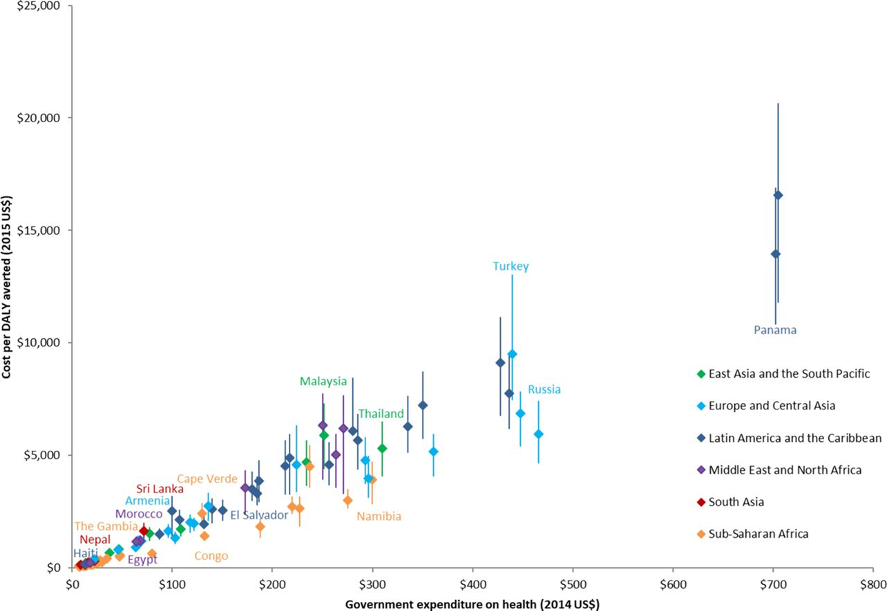
Estimates using country level data
Ochalek J, Lomas J, Claxton K. Estimating health opportunity costs in low-income and middle-income countries: a novel approach and evidence from cross-country data. BMJ Global health. 2018 Nov 5;3(6):e000964. https://doi.org/10.1136/bmjgh-2018-000964
Ochalek J, Claxton K, Lomas J, Thompson KM. Valuing health outcomes: developing better defaults based on health opportunity costs. Expert Review of Pharmacoeconomics & Outcomes Research. 2020 Sep 20;1-8. https://doi.org/10.1080/14737167.2020.1812387
Word Bank categories | GDPpc per DALY
Low income | 18%
Low middle income | 15%
High middle income | 55%
High income | 114%

Slide 36
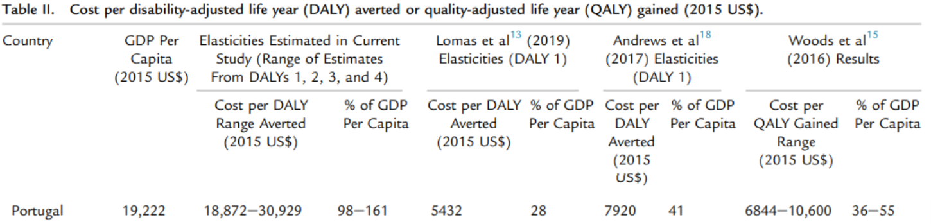
Estimates using published elasticities
Plausible range of 6,000 to 10,000 Euros per QALY
Ochalek, J. M., & Lomas, J. (2020). Reflecting the Health Opportunity Costs of Funding Decisions within Value Frameworks: Initial Estimates and the Need for Further Research. Clinical Therapeutics, 42(1), 44-59. https://doi.org/10.1016/j.clinthera.2019.12.002

Slide 37
Implications for other countries?
Evidence based assessment of health opportunity costs
Implications of existing estimates
Estimation using within country data
Evidence based pricing policy
Accounting for dynamic effects (domestic or global)
What share of value are you currently paying?
What are the benefits of moving to dynamically efficient pricing policy?
How are dynamic benefits distributed globally?
Establishing practical payment mechanisms informed by HTA
Subscription models (delinked reward systems)
Guaranteed post-patent prices
National rebate mechanisms
Product specific HTA approval norms?

Slide 38
A practical evidence based mechanism
NICE Appraisal
Benefits, costs
Appropriate volume
Centre (DH)
Rebate required
Appropriate volume
Rebate beyond volume
Assessment
Cost to produce 1 QALY and share to offer
Manufacturer
Agrees to include in rebate calculation
Pays rebate based on sales
Prescriber
Pays manufacturer
Fully reimbursed by centre

Slide 39
A practical evidence based mechanism
NICE Appraisal
Benefits, costs
Appropriate volume
Centre (DH)
Rebate required
Appropriate volume
Rebate beyond volume
Assessment
Cost to produce 1 QALY and share to offer
Manufacturer
Agrees to include in rebate calculation
Pays rebate based on sales
Manufacturer
Does not agree to include in rebate calculation
Prescriber
Pays manufacturer
Fully reimbursed by centre
Prescriber
Pays manufacturer
Not reimbursed

Slide 40
A practical evidence based mechanism
NICE Appraisal
Benefits, costs
Appropriate volume
Centre (DH)
Rebate required
Appropriate volume
Rebate beyond volume
Assessment
Cost to produce 1 QALY and share to offer
Manufacturer
Agrees to include in rebate calculation
Pays rebate based on sales
Manufacturer
Does not agree to include in rebate calculation
Crown purchase
Licence generics
Prescriber
Pays manufacturer
Fully reimbursed by centre
Prescriber
Pays manufacturer
Not reimbursed
Prescriber
Early access to generic or
bio similar

Slide 41
Application to a sample of NICE Technology Appraisals
 | HEc (2021) |  |  | Optimal analysis
Product | Final Appraisal Determination ICER (£ per QALY) | Implied price premium (£) | Estimated share of value to manufacturer | Share to manufacturer | Optimal implied price premium under IPP (£) | Optimal approval norm under IPP (£ per QALY)
Nalmefene | 1,110 | 322 | 9% | 22% | 784 | 7,910
Vortioxetine | 2,970 | 49 | 7% | 22% | 157 | 9,234
Rivaroxaban | 5,622 | 309 | 6% | 22% | 1,136 | 12,519
Thalidomide | 9,174 | 10,862 | 19% | 22% | 12,565 | 10,570
Adalimumab | 19,328 | 26,725 | 114% | 22% | 5,143 | -3,632§
Vedolizumab | 21,620 | 2,328 | 144% | 22% | 357 | 10,671
Enzalutamide (pre) | 32,985 | 27,590 | 79% | 22% | 7,687 | -6,820 §
Pembrolizumab (NSCLC) | 44,490 | 22,756 | 260% | 22% | 1,928 | 10,120
Cabazitaxel | 45,159 | 10,703 | 118% | 22% | 1,993 | 8,407
Enzalutamide (post) | 45,626 | 11,022 | 168% | 22% | 1,442 | 8,782
Pembrolizumab (melanoma) | 46,662 | 36,953 | 243% | 22% | 3,347 | 8,902
Olaparib | 46,973 | 34,883 | 148% | 22% | 5,181 | 9,845
Woods, B., Fox, A., Sculpher, M., & Claxton, K. (2021). Estimating the shares of the value of branded pharmaceuticals accruing to manufacturers and to patients served by health systems. Health Economics, 1-18. https://doi.org/10.1002/hec.4393

Slide 42
Pricing policy to achieve dynamic efficiency?
Long-term post-patent value of a new product (static health benefits)
But what share of this long-term value should be offered to manufacturers?
How does quantity and quality of innovation respond to payment?
What payment of health care resources is required?
How best to deliver that payment?
Approval norms, guaranteed post patent prices, subscription models, rebate mechanisms
SUMMARY of Report 065 - Woods B, Lomas J, Sculpher M, Weatherly H, Claxton K, (2022) Achieving dynamic efficiency in pharmaceutical innovation: identifying the optimal share of value, the payments required and evaluating pricing policies.
Woods, B., Lomas, J., Sculpher, M., Weatherly, H. L. A., & Claxton, K. P. (2024). Achieving dynamic efficiency in pharmaceutical innovation: Identifying the optimal share of value and payments required. Health Economics, 33(4), 804-819. Article hec.4795. https://doi.org/10.1002/hec.4795

Slide 43
How does quantity and quality of innovation respond to payment?
Systematic review of literature
Plausibly causal estimates of effect of payment on outputs and outcomes
Wide range of estimates of the quantity of innovation elasticity
Unexplained heterogeneity
Evidence of publication bias
Overall elasticity of 0.45 (CBO)
Range 0.23 (Dubois et al., 2015) to 1.5 (Philipson & Durie, 2021)
Limited evidence of the effect on the quality of innovation
1% increase in quantity associated with 0.56% decline in quality (Bennette et al., 2019)
No literature on the effect of payment on manufacturing costs

Slide 44
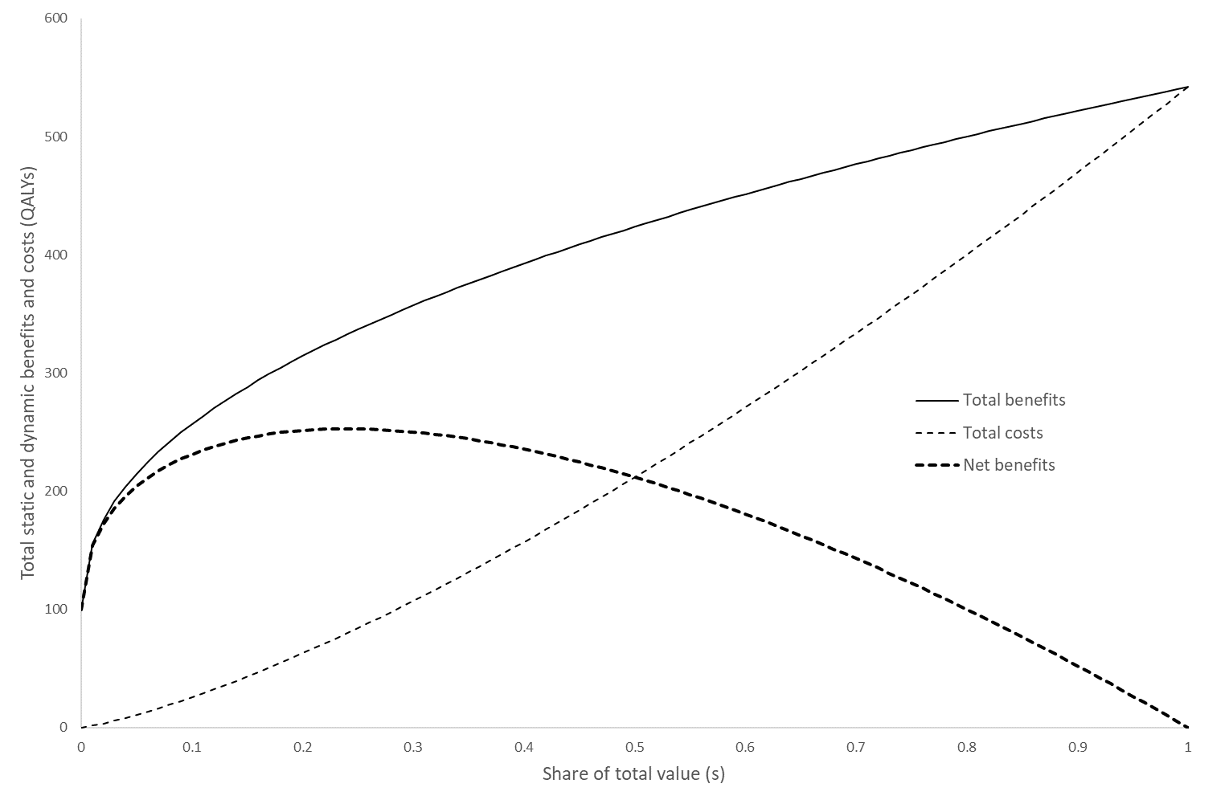
Benefits and costs of different shares of value
Dynamic benefit
Static benefit
s*

Slide 45



Share to optimal payment and approval norms (λ)
£330,000/5 QALYs = £66,000 per QALY
${Payment=s}^{∗}. T_{b}$. 𝑘
$$=0.22∗100 QALYs∗£15,000$$
$$=£330,000$$
£330,000/80 QALYs = £4,125 per QALY

Slide 46
What type of QALYs are lost/gained and what are the other effects of changes in expenditure?
The effects of 1 QALY gained or lost in each ICD code
Proportionate Shortfall (% QALY loss) |  |  | Absolute Shortfall (QALY loss) |  |  | Wider Social Benefits (net production) per QALY
C22 | Liver cancer | 73% | C22 | Liver cancer | 10.70 | M05 | Rheumatoid arthritis | £30,034
C25 | Pancreatic cancer | 73% | C25 | Pancreatic cancer | 9.97 | E11 | Diabetes | £27,421
C34 | Lung cancer | 71% | C34 | Lung cancer | 9.68 | M45 | Ankylosing spondylitis | £26,190
C92 | Myeloid leukaemia | 38% | F20 | Schizophrenia | 7.62 | F30 | Depression | £23,489
G20 | Parkinson's disease | 31% | G35 | Multiple sclerosis | 6.18 | F20 | Schizophrenia | £22,697
C90 | Myeloma | 31% | C92 | Myeloid leukaemia | 6.15 | J45 | Asthma | £20,100
C64 | Kidney cancer | 22% | G20 | Parkinson's disease | 4.60 | M81 | Osteoporosis | £17,910
G35 | Multiple sclerosis | 18% | C90 | Myeloma | 4.45 | G35 | Multiple sclerosis | £15,482
J43 | Emphysema and COPD | 17% | J43 | Emphysema and COPD | 3.80 | J43 | Emphysema and COPD | £14,525
G30 | Alzheimer's disease | 14% | C64 | Kidney cancer | 3.75 | G40 | Epilepsy | £14,245
F03 | Dementia | 14% | F30 | Depression | 3.63 | L40 | Psoriasis | £11,890
F20 | Schizophrenia | 12% | M05 | Rheumatoid arthritis | 2.83 | Displaced | Average of displaced QALYs | £11,611
M05 | Rheumatoid arthritis | 11% | E11 | Diabetes | 2.68 | E66 | Obesity | £8,138
C61 | Prostate cancer | 11% | Displaced | Average of displaced QALYs | 2.07 | C53 | Cervical cancer | £6,912
I26 | Embolisms, fibrillation, thrombosis | 11% | J45 | Asthma | 1.86 | K50 | Irritable Bowel Syndrome | £6,284
E11 | Diabetes | 11% | G30 | Alzheimer's disease | 1.68 | J30 | Allergic rhinitis | £5,234
C18 | Colon cancer | 10% | F03 | Dementia | 1.68 | G20 | Parkinson's disease | £3,102
I21 | Acute myocardial infarction | 9% | G40 | Epilepsy | 1.32 | C50 | Breast cancer | £2,888
I64 | Stroke | 8% | C18 | Colon cancer | 1.28 | G30 | Alzheimer's disease | £351
Displaced | Average of displaced QALYs | 8% | I26 | Embolisms, fibrillation, thrombosis | 1.16 | A40 | Streptococcal septicaemia | -£513
F30 | Depression | 6% | C61 | Prostate cancer | 1.06 | F03 | Dementia | -£2,430
G40 | Epilepsy | 4% | I21 | Acute myocardial infarction | 1.00 | I64 | Stroke | -£6,949
J45 | Asthma | 4% | I64 | Stroke | 0.83 | C18 | Colon cancer | -£8,061
C50 | Breast cancer | 3% | C53 | Cervical cancer | 0.60 | C61 | Prostate cancer | -£10,602
C53 | Cervical cancer | 3% | C50 | Breast cancer | 0.55 | C64 | Kidney cancer | -£13,211
L40 | Psoriasis | 2% | A40 | Streptococcal septicaemia | 0.38 | I21 | Acute myocardial infarction | -£14,395
J10 | Influenza | 2% | J30 | Allergic rhinitis | 0.30 | I26 | Embolisms, fibrillation, thrombosis | -£16,752
M81 | Osteoporosis | 2% | M81 | Osteoporosis | 0.28 | J10 | Influenza | -£21,568
J30 | Allergic rhinitis | 2% | K50 | Irritable Bowel Syndrome | 0.26 | C90 | Myeloma | -£23,382
A40 | Streptococcal septicaemia | 2% | J10 | Influenza | 0.19 | C92 | Myeloid leukaemia | -£24,813
K50 | Irritable Bowel Syndrome | 1% | L40 | Psoriasis | 0.19 | C22 | Liver cancer | -£32,709
E66 | Obesity | 0% | E66 | Obesity | 0.18 | C34 | Lung cancer | -£36,067
M45 | Ankylosing spondylitis | 0% | M45 | Ankylosing spondylitis | 0.11 | C25 | Pancreatic cancer | -£53,860
Claxton, K., Sculpher, M., Palmer, S., & Culyer, A. J. (2015). Causes for concern: is nice failing to uphold its responsibilities to all NHS patients? Health Economics, 24(1), 1-7.
Chapter 4 in Drummond MF., Sculpher MJ., Claxton K., Stoddart GL. and Torrance GW (2015), Methods for the economic evaluation of health care programmes (4th edition), Oxford Medical Publications.

Slide 47
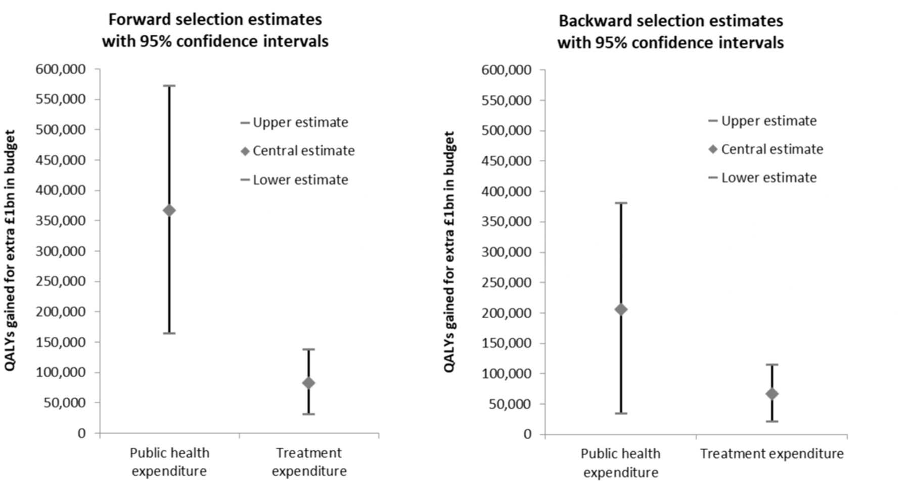
Health effects of Public Health and NHS expenditure 2013/14
Analysis of PH and NHS spend 13/14 on all cause mortality and QALYs
Martin S, Lomas J, Claxton K. Is an ounce of prevention worth a pound of cure? A cross-sectional study of the impact of English public health grant on mortality and morbidity. BMJ Open. 2020 Oct 10;10(10).

Slide 48
Some policy implications
Implications for
Pharmaceutical pricing
NICE approval of new technologies
Level of public expenditure and its allocation
NHS, Public Health, Adult Social Care (eligibility and intensity)
Mortality distribution and disease area
Primary care, CCG and specialised commissioning
Health benefits of public expenditure on health and social care
Marginal value of public funds
Likely consequences of austerity
Extent of underfunding (health, public heath and social care)
Longo, F., Claxton, K. P., Griffin, S., Mason, A. R., Walker, S. M., & Weatherly, H. L. A. (2024). Social Decision-Making Analysis: A General Approach to Inform Decisions on Resources in the Public Sector. Accepted for publication, Value in Health. https://doi.org/10.1016/j.jval.2024.01.015
Lomas, J., Claxton, K., S Longo, F., & Salas-Ortiz, A. Estimating the health benefits of increasing and reallocating expenditure on the National Health Service in England. Submitted to Health Economics, Policy and Law.

